Slide 1


Final Project Evaluation Work Plan
Warrap Reconstruction for Peace & Human Security Project, Warrap State, South Sudan
By : NETC Consultancy 01 Dec 2015
Kuajok
1

Slide 2

Presentation Outline
Introduction (NETC)
Project Background
Evaluation objectives
Evaluation framework
Methodology
Manpower
Quality control
Deliverables
Schedule
What next ?
2

Slide 3
NETC Firm Profile
Established: FY 2009
Staff: 6 permanent staff with diverse professional mix & experience
Experience: conducted more than 50 project evaluations, reviews & baseline surveys
Customers: WVE, Save the Children, Concern WW, Action Aid, IMC, GOAL, CRS, Trocaire and others
NETC staff for Warrap Project : Kassahun Tezera (lead)
Wasihun Eshetu
3

Slide 4
NETC Preliminary Work
Contract agreement signed with WV SS
Quick review of project documents
Draft and shared evaluation tools
Tentative Field Study Work Plan Developed
NETC consultants arrived at Kuajok
Work plan briefing, discussion and refine evaluation plan
4

Slide 5
Project background
Project title: Warrap Reconstruction for Peace & Human Security Project
Goal : Increase human security through peace building & promotion of the rule of law, creating a peace dividend through sustainable use and management of natural resources to ensure food and water security.
Implemented by: World Vision South Sudan
Beneficiaries: 715,140 People
5

Slide 6
Project background…
Fund Source: The Netherlands Gov’t
Total Budget: USD 5.689.411 (for 3.5 Years)
Geographic Focus: Five Counties
Gogrial West
Gogrial East
Tonj North
Tonj South
Tonj East
6

Slide 7
Project background…
Intervention areas : Protection
Peace building
Food Security
Livelihood
WASH
Life span: July 01, 2012 to December 31, 2015
7

Slide 8
Project Outcome
1. Improved capacity and willingness of community members and local government to identify and respond to issues of human security, protection & peace, particularly for women and girls:
2. Reduced conflicts through support for livelihoods alternative to cattle and promoting stabilization through enhance food security by increased production and diversification of sustainable agro-pastoral livelihoods opportunities
8

Slide 9
Project Outcome
3. Create a peace dividend through skill development for youth and women in support of alternative income generating opportunities and enhanced access to markets.
4. Reduced natural resource conflicts related to water and grazing land, and creating a peace dividend through visible investment in basic water and sanitation infrastructure
9

Slide 10
Evaluation Objectives
To assess the overall project performance and
achievements against the baseline data
2. To assess the scope, quality & usefulness of the project outputs & outcomes achieved in relation to its objective
3. To draw lessons learnt from project implementation that will be useful for similar projects in the future.
4. To determine efficiency, consistency, effectiveness, relevance and sustainability of the project
10

Slide 11
Evaluation Framework
Impact
Relevance
Efficiency
Effectiveness
Sustainability
Coverage
Gender sensitivity
Baseline
Log frame / WP
Mid-term
Progress reports
Other supporting documents
11

Slide 12
Evaluation guiding principles
Terms of Reference (ToR)
WVSS – Learning through Evaluation with Accountability & Planning (LEAP)
Standard M & E tools (NETC)
12

Slide 13
Methodology
Will follow mid-term evaluation procedure
Multi-sectoral & multi-counties (5)
Primary & secondary data sources
Quantitative & qualitative data
Desk review (relevant documents)
Household Interview (HH)
Focus Group Discussion (FGD)
Key Informant Interview (KII)
Observation / site visit
13

Slide 14
Methodology...
It will accept up to 5% margin of error (95% CI)
Two-stage cluster sampling
1st - Boma - to select villages (PPS)
2nd - Village – to select HHs (SRS)
Sample size : Slovene's formula - n= N/(1+Nxe²)
n = 119,190/ [1+119,190 (0.05X0.05)]
=119,190/299
= 400
N = Population size (HHs) & n = sample size
Projection of 2008 Census
14

Slide 15
Households
County | Pop. Size | HHs | PPS | # HHs
Gogrial West | 243,921 | 40,654 | 34% | 136
Gogrial East | 103,283 | 17,214 | 14% | 58
Tonj North | 86,592 | 14,432 | 12% | 48
Tonj East | 165,222 | 27,537 | 23% | 92
Tonj South | 116,122 | 19,354 | 16% | 65
Total | 715,140 | 119,190 | 100% | 400
15

Slide 16
Focus Group Discussion
County | Women Group | Men Group | Youth Group | WASH Comm. | Peace Comm. | Total
Gogrial West | 1 | 1 | 1 |  |  | 3
Gogrial East |  | 1 | 1 |  |  | 2
Tonj North |  | 1 | 1 |  |  | 2
Tonj East | 1 |  |  | 1 |  | 2
Tonj South |  |  | 1 | 1 |  | 2
Total | 2 | 3 | 4 | 2 |  | 11
16

Slide 17
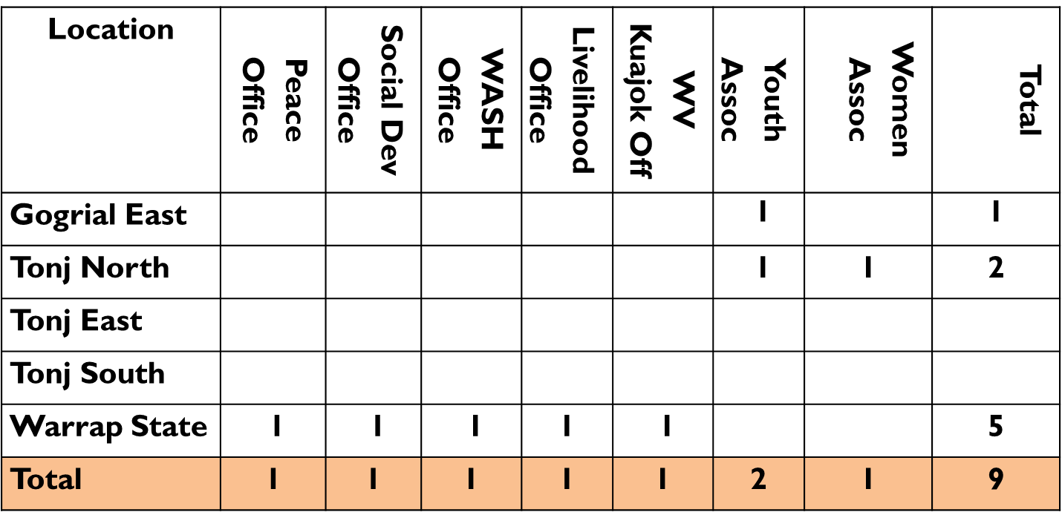
Key Informant
17

Slide 18
Observation / field visit
Institution service delivery points
Demonstration sites (FFS)
Infrastructures (e.g raod etc)
Natural resource
Besides: -
Promising practices
Case studies
Photo – before & after
Award / recognition
Lessons learnt…
18

Slide 19
Manpower
NETC consultants – two
Training - Supervisors
- Enumerators
- Local guides
- Data entry, cleaning & analysis (SPSS)
WVSS Project staff - technical support
- logistic & security issue
Government staff & Key actors will take part
19

Slide 20
Quality control
Participatory (tools & data collection)
Clear data collection tools & guides
SMART planning & coordination
Assign clear roles & responsibilities
Recruitment based on qualification & experience
Training and pre-test of assessment tools
Close supervision in the field & provide feedback
Data quality check on daily basis
Confidentiality & proper introductions
20

Slide 21
Deliverables
Detailed work plan & schedule
Study tools
Preliminary results (debriefing)
Draft report
Final report (soft copy)
All raw data in softcopies
21

Slide 22
Schedule
SN | Major Activities | Date | Location
1 | Agreement signing | 23 Nov 2015
2 | Develop evaluation tools | 25 Nov 2015
3 | NETC fly to Juba | 30 Nov 2015
4 | NETC fly to Kuajok | 01 Dec 2015
5 | Initial briefing & discussion | 02 Dec 2015 | Warrap
6 | Training & data collection | 03 - 14 Dec
7 | Debriefing | 15 Dec 2015
8 | Travel to Juba then Addis | 16 - 17 Dec | Juba
9 | Preliminary report | 05 Jan 2015 | A.A
10 | Final report | 30 Jan 2015 | A.A
22

Slide 23
What next ?
Revise the work plan & schedule as a team
Revise & finalize the study tools
Split the team in to two groups
Training the study team
Pretesting the study tools & print final version
Conduct the field work
23

Slide 24


Thank You !!!

